Slide 1
Using the Request and Server Context Through Built-in Object

Slide 2

Request
Response PageContext Out
Module Overview
Session
Application Config

Slide 3
Request

Slide 4
Request Object
Methods
setAttribute
getAttribute getCookies() getHeaderNames() getHeader(string name) getMethod()
get Parameter(string name) getQueryString(string name) getLocale()

Slide 5
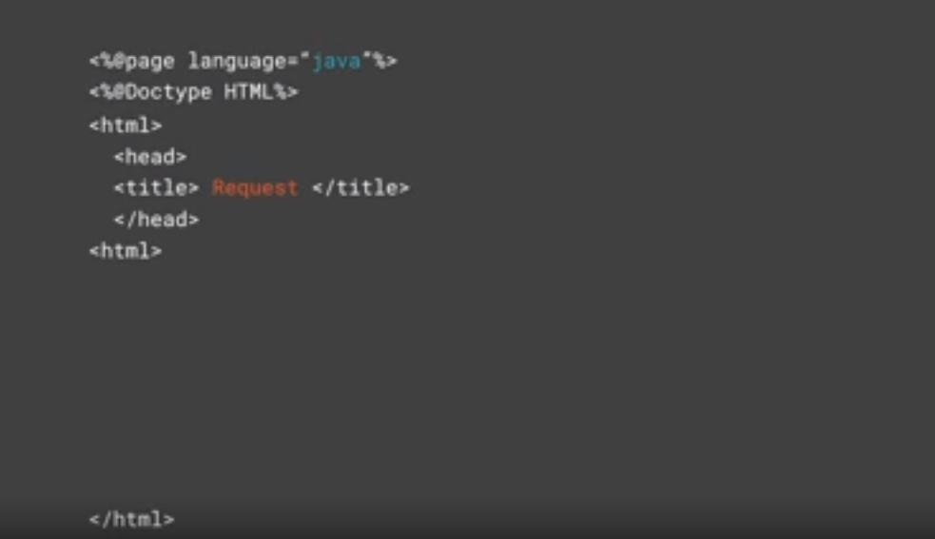

Slide 6
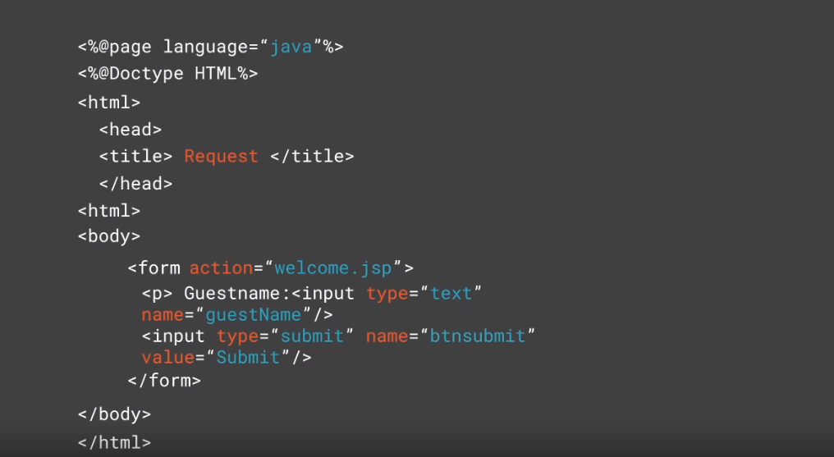

Slide 7
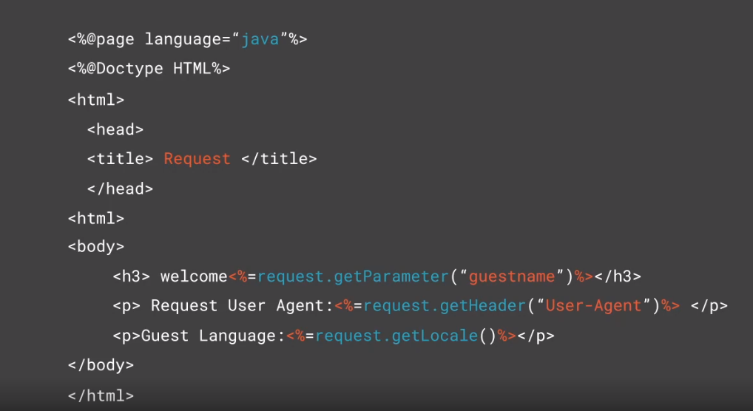

Slide 8
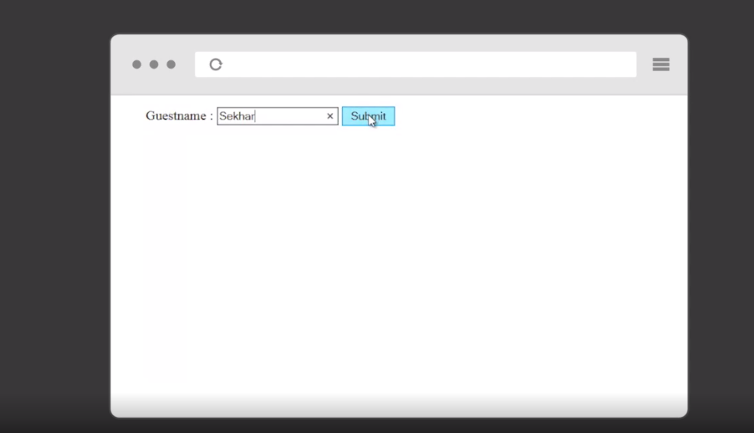

Slide 9
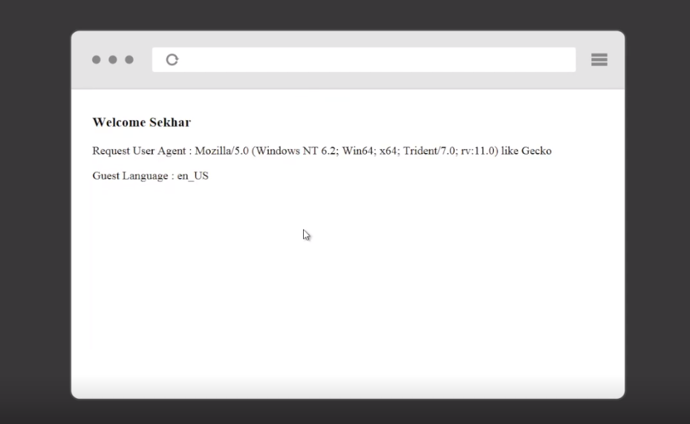

Slide 10
Response

Slide 11
response object
setIntHeader(String name,Int value) response.setHeader("Refresh",5)
setContentType(Str
response.setContentTyp
ing type)
e("text/html")
sendRedirect(String location) response.sendRedirect("sucess.jsp")
addCookie(Cookie cookie) response.addCookie(userCookie)

Slide 12

Assisted Practice
response

Slide 13
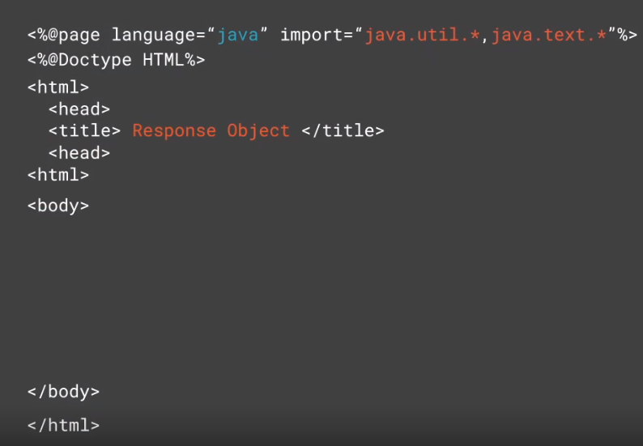

Slide 14
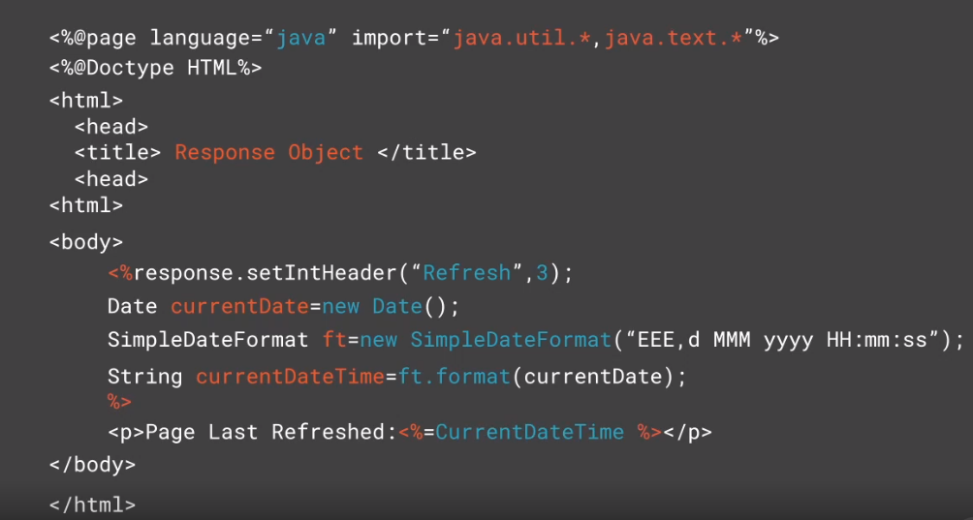

Slide 15
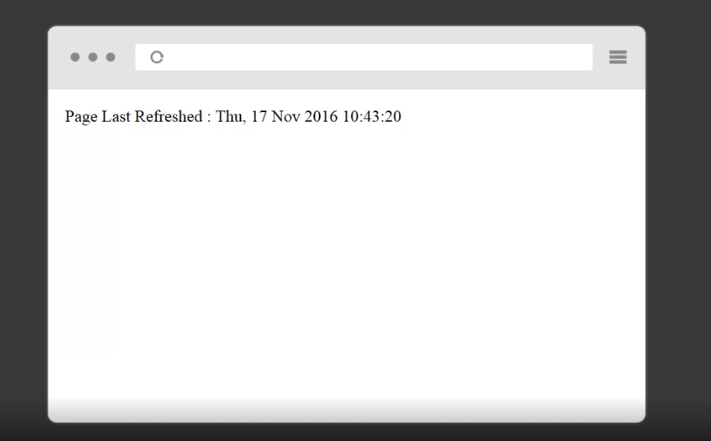

Slide 16
Out

Slide 17
In Servlets
In JSP
Out [Builtin Object]
jspWriter out=pagecontext.getout()
Throws IOException
Prinitwriter out =response.getWriter();

Slide 18
print
printIn flush
Out Builtin Object Methods

Slide 19
out.print("Today is:"+java.util.Calendar.getInsatance().getTime());
Syntax
To display the current date and time

Slide 20
PageContext

Slide 21
setAttribute
getAttribute findAttribute removeAttribute
Important Methods to PageContext

Slide 22
◀ To set a page -scoped attribute
<%Float no1=new Float (62.5)%>
<%pageContext.setAttribute("no1“,no1);
%>
<%pageContext.getAttribute("no1“,no1)
%>
<%Float no2=new Float(84.3)%>
<%pageContext.setAttribute
("no2“,no2,PageContext.”SESSION_SCO PE");%>
<%pageContext.getAttribute ("no2“,PageContext.”SESSION_SCOPE")
;%>
◀ To read a page -scoped attribute
◀ To set a session-scoped attribute
◀ To read a session-scoped attribute

Slide 23
Session

Slide 24
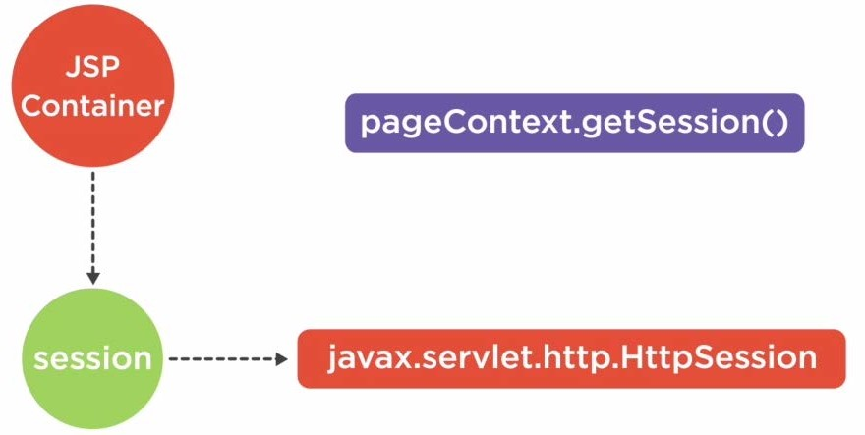
Session Object

Slide 25
setAttribute ( String name,Object value)
getAttribute(String name) removeAttribute(String name)
Session Builtin
Object

Slide 26
<% pageContext.setAttribute
("no",value,PageContext.SESSION_SCOPE); %>
<%session.setAttribute("no",value)%>
Syntax
To set the session

Slide 27
Application

Slide 28
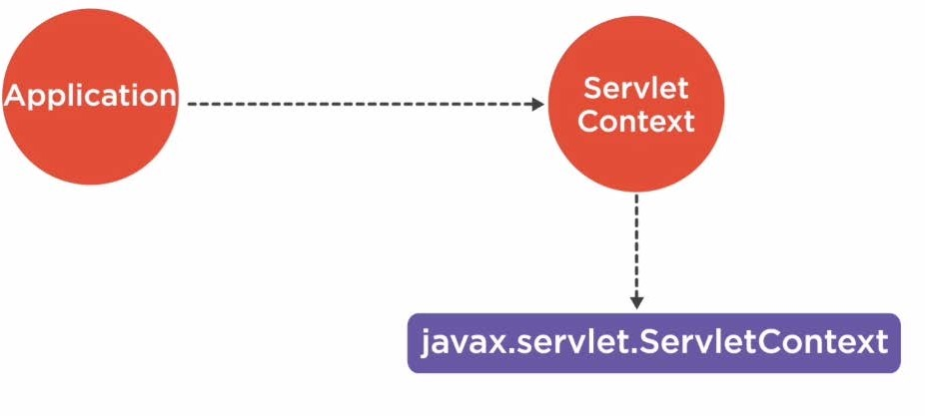
Application Object
javax.servlet.ServletContext application=pageContext.getServeltContext()

Slide 29
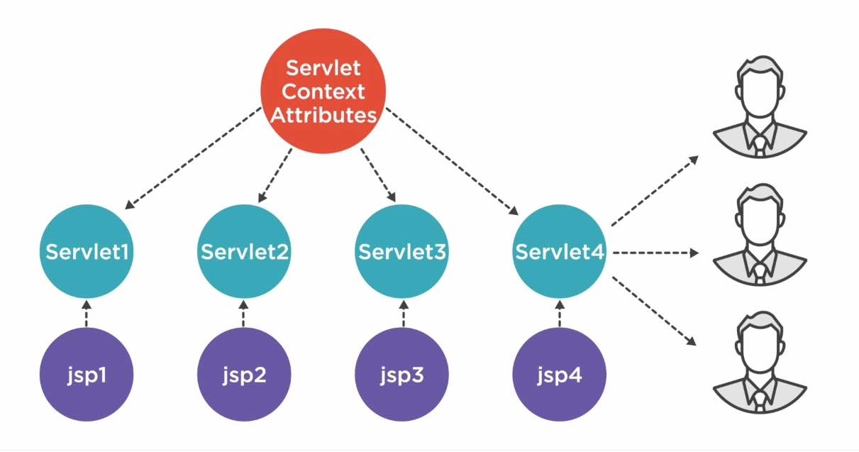
Application Object

Slide 30
application.setAttribute(String name,Object value)
Syntax
To Set

Slide 31
application.getAttribute(String name)
Syntax
To Read

Slide 32
Config

Slide 33
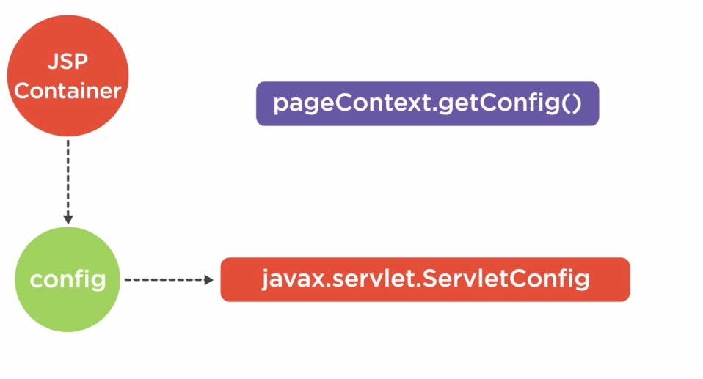
Config Object

Slide 34
getInitParameter(String name)
getInitParameterNames() getServletContext() getServletName()
Config Implicit
Object

Slide 35
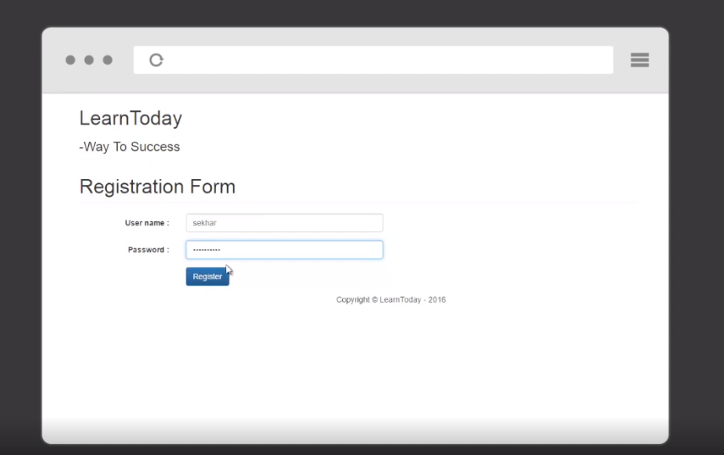

Slide 36
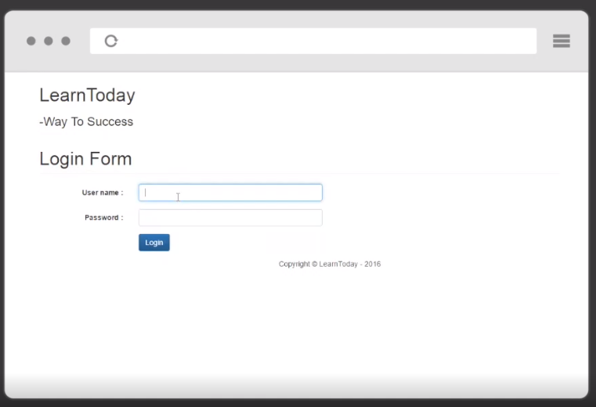

Slide 38
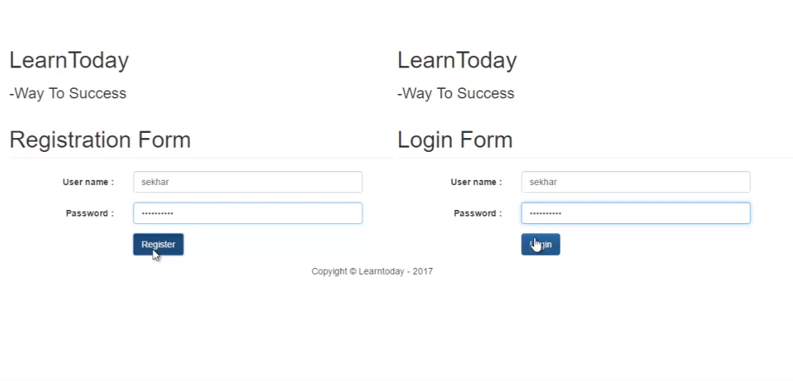

Slide 39
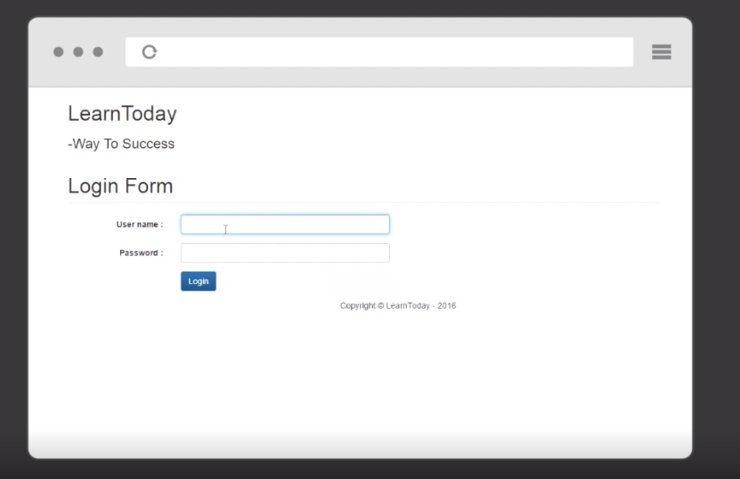

Slide 40
Request
Response PageContext Out
Summary
Session
Application Config

